Slide 1

Note: The data and information in this document is reflective of a hypothetical situation and client. This document is to be used for KPMG Virtual Internship purposes only.
Sprocket Central Pty Ltd
Data analytics approach
Niraj KC

Slide 2
Note: The data and information in this document is reflective of a hypothetical situation and client. This document is to be used for KPMG Virtual Internship purposes only.
Agenda
Introduction
Data Exploration
Model Development
Interpretation

Slide 3
Note: The data and information in this document is reflective of a hypothetical situation and client. This document is to be used for KPMG Virtual Internship purposes only.
Introduction
Content of data analysis
Profit in association with gender.
Individual customer profit contribution.
Category of bikes in profit
Month-wise profit calculation.
State-wise profit calculation.
Potential customers and RFM value.
1000 new customers should be targeted to drive the most value for the organisation.
Problems Outlines
Sprocket Central Pty Ltd is a bikes & cycling accessories organisation .Currently it is looking to boost its business.
The company marketing team has been provided with 3 data sets. They have to analyze the data to search the 1000 potential customers.
This can be done with-data exploration, model development, and interpretation.

Slide 4
Data Exploration
Data Quality Assessment and ‘Clean Up'
 | Accuracy | Completness | Consistency | Currency | Relevancy | Validity | Uniqueness
Customer Demographic | DOB: Inaccurate Age: missing | Job title: Blanks Customer id: Incomplete | Gender: Inconsistency | Deceased customer updated | Default column deleted |  | Customer id: duplicated removed
Customer Address |  | Customer id: Incomplete | State: Inconsistency
Transition | Profit: missing | Customer id: incomplete Online Orders: blanks Brand: blanks |  |  | Cancelled status order: filter out | List price: format Product sold date: formate
Key Issues for Data Quality Assessment
Accuracy: Correct Values
Completeness: Data Fields with Values
Consistency: Values Free from contradiction
Currency: Values up to Date.
Relevancy: Data items with Values Meta-data.
Validity: Data containing Allowed Values.
Uniqueness: Records that are Duplicated.
.

Slide 5
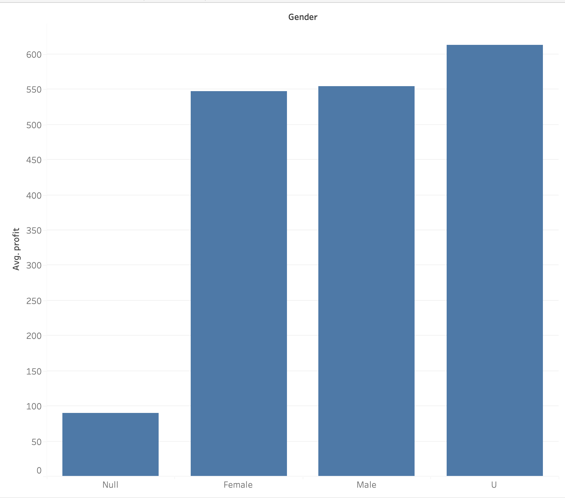
Data Exploration
Gender Wise Profit contributions
As gender wise profit contribution, there is
not more differences.
Unisex contributed little more than other
genders.
Male and Female contribution is somewhat
similar.

Slide 6
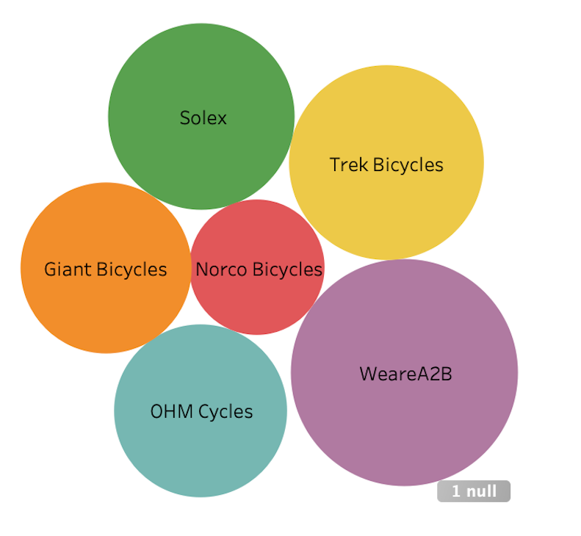
Data Exploration
Types of bikes that are sold more recently
WeareA2B was the most sold bike.
Second sold bike was Trek, followed
by Solex, OHM, giant respectively.
Least sold bike was Norco.

Slide 7
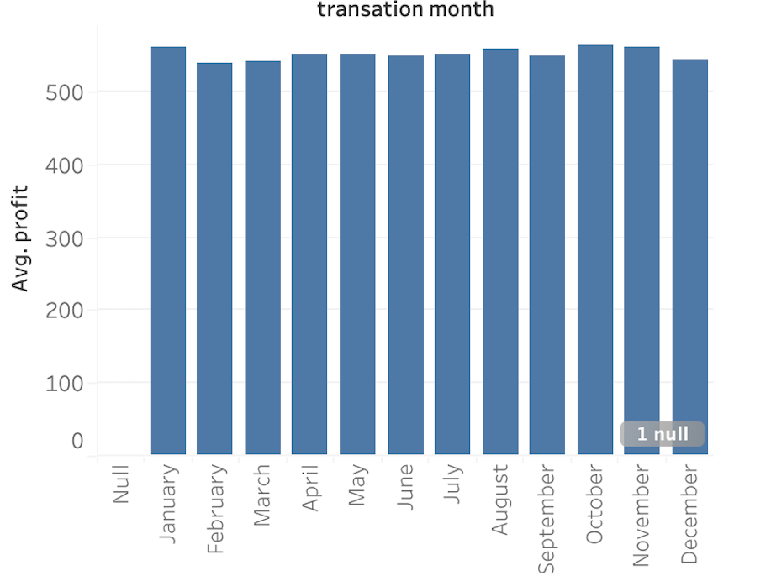
Data Exploration
Month-wise transition of bikes
There was no significantly
differences between the
months in the sold bikes.
However, January month
has the highest.

Slide 8
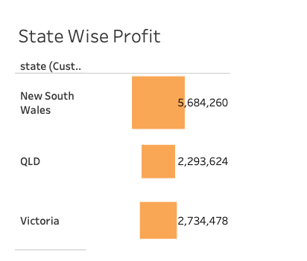
Data Exploration
State-Wise bike sell
New South wales has the highest
record of selling bikes in last 3
years with more than 50%.
Second was Queensland.
Third comes under Victoria.

Slide 9
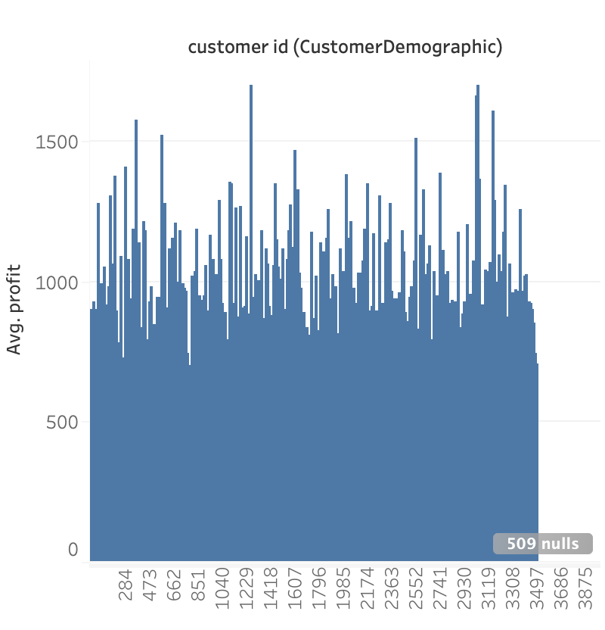
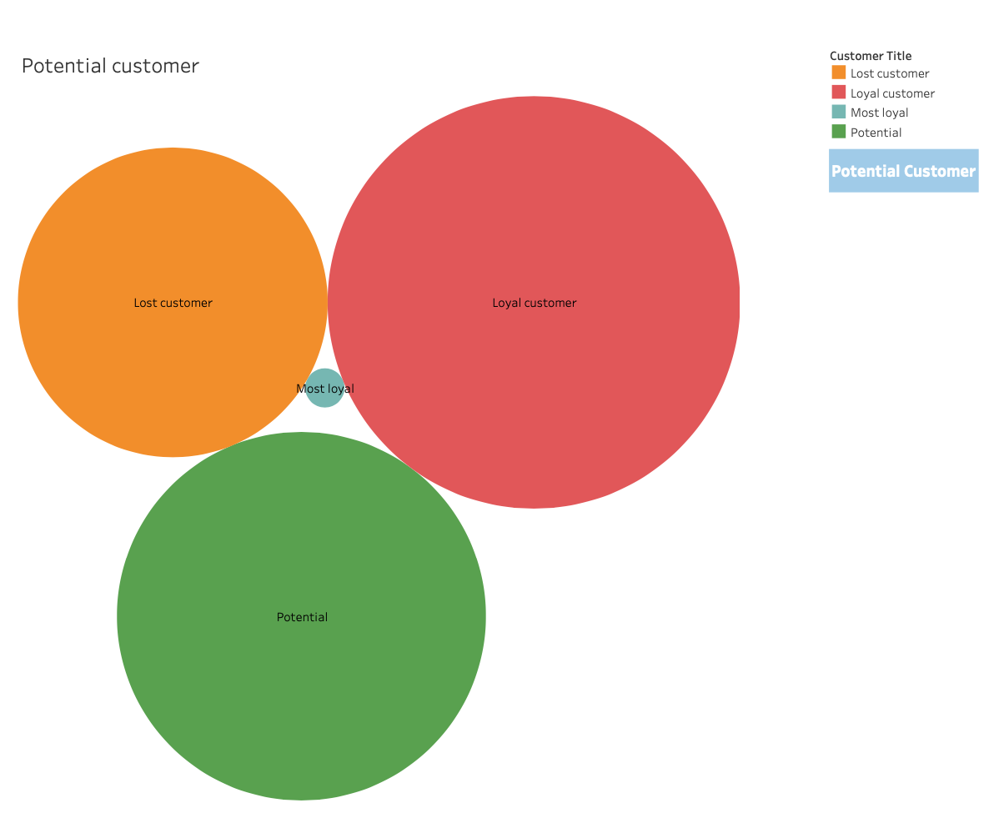
Model Development
RFM and Customer Category
RFM( Recency, Frequency, and Monetary) analysis was done to know the potential customer for increasing business. The analysis was done based on above 3 mentioned factors.
Customers with the highest score of RFM is known as most loyal customer, than after Loyal customer which are giving more business after most loyal customer.
Customer with least potential is shown as Lost customer.
The first graph is showing the business given by each customer in past 3 years.
Place any supporting images, graphs, data or extra text here.

Slide 10
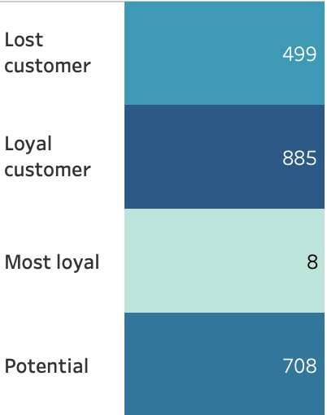
Interpretation
Summary of top 1000 customer to be targeted
The top 1000 customers shown in the fig. below had bought recently, frequently and spent more money then other customers.
The description of each level of customer is shown in table below.
Rank | Description
1)Very Loyal customer | Most recent buy, buys often, most spent
2) Loyal customer | Most recent, buys often, spends large amount of money
3) Potential customer | Bought recent, not very often, average spend
4) Lost customer | Very low RFM value
Place any supporting images, graphs, data or extra text here.

Slide 11
Note: The data and information in this document is reflective of a hypothetical situation and client. This document is to be used for KPMG Virtual Internship purposes only.
Appendix

